Slide 1
Introduction to R Programming
Marek Strejczek
Version 1.1
2016-04-05

Slide 2
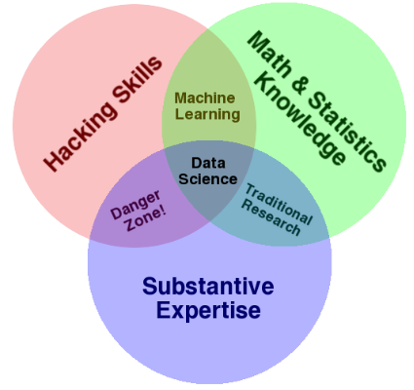
About me
Chapter 1
Technical Architect at GFT Poland
12 years of experience in software design and development
Telco
Finance
Specialized in Java technologies
Exploring the world of data-related technologies – looking for innovative ways of tackling problems.

Slide 3
What is R
Chapter 1
Language and environment for statistical computing and graphics.
GNU project
Started in early 90’s
Similar to S language developed in 70’s
Very popular for statistical research. Provides packages for:
Data access
Data cleaning
Analysis
Reporting
Excels at interactive data exploration
Very active community

Slide 4
Statistical features
Chapter 1
Many statistical and graphical techniques available out of the box or with additional packages
Linear and non-linear modeling
Statistical tests
Time-series analysis
Classification
Clustering
Graphics (static, dynamic, interactive)
Lots of packages at Comprehensive R Archive Network (CRAN)

Slide 5
Showtime!
Chapter 1
Vectors
Matrices
Lists
Factors
NA, NaN
Subsetting
Control structures: if, for, while, repeat
Functions
*apply (apply, lapply, sapply, mapply, tapply), split
Statistics

Slide 6
Showtime!
Chapter 1
Built-in datasets
Apache log file analysis
Hospital data analysis
Useful packages not explored during this demo:
ggplot2 – plotting library
data.table – extension to data.frame, supports large data sets

Slide 7
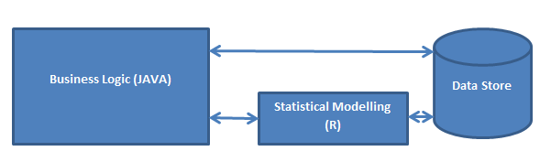
Enterprisey solutions
Chapter 1
Statistical engine
rJava
Rserve
statConn
R.NET
Renjin – JVM based R interpreter
SparkR – R interface for Apache Spark
Enterprise solutions:
Oracle Enterprise R – part of Oracle Advanced Analytics Option
Can run R against data managed by Oracle database
Microsoft R Server – enterprise-class analytics platform based on R.
Can integrate with Hadoop, Teradata, SQL Server
Based on Revolution Analytics – Big Data Analytics platform acquired in 2015 by Microsoft.

Slide 8
Example of use
Chapter 1
Credit risk analysis
„what if” scenario analysis at a large investment bank
.NET frontend
Coherence cluster
~1.5 TB
StatConnector
R Interpreter
JVM
rJava

Slide 9
Resources
Chapter 1
https://cran.r-project.org – CRAN home
https://www.rstudio.com/ - R Studio (IDE) home
http://www.r-bloggers.com/ - R news and tutorials
https://spark.apache.org/docs/latest/sparkr.html – Spark on R
http://www.renjin.org/ - JVM-based interpreter of R
https://www.rforge.net/rJava/ - R-to-Java interface
https://rforge.net/Rserve/doc.html - Server that exposes R interface
http://homepage.univie.ac.at/erich.neuwirth/php/rcomwiki/doku.php?id=start – statConn – tools that allow embedding R in Windows applications
https://rdotnet.codeplex.com/ - R - .NET integration
https://www.youtube.com/watch?v=EI8a6hFFRGQ – The F#orce Awakens talk by Evelina Gabasowa about using R from F# (Lambda Days 2016)
https://mran.microsoft.com – Microsoft R Open – enhanced distribution of R.
https://www.microsoft.com/en-us/server-cloud/products/r-server/ - Microsoft R Server – enterprise analytical platform
https://oss.oracle.com/ORD/ - Oracle R Distribution – enhanced distribution of R
http://www.oracle.com/technetwork/database/database-technologies/r/r-enterprise/overview/index.html - component of Oracle enterprise analytical platform

Slide 10
GFT Poland sp. z o.o.
Marek Strejczek
Technical Architect
Sterlinga 8a
91-425 Łódź
Poland
T +48 606296955
marek.strejczek@gft.com

